Slide 1
Predicting Life Satisfaction
March 19, 2020
Matthew Fultz (20639612)
Jack Swiatoschik (20607842)

Slide 2
Dataset Characteristics
Binary response (either satisfied or not satisfied)
Both categorical and numerical features
Many predictors - some of which are collinear

Slide 3
Pre-Processing

Slide 4
Data Cleaning
Special Value | Partner’s Highest Level of Education | Mother’s Highest Level of Education
a. | Not Applicable | Refusal
b. | Refusal | Don’t know
c. | Don’t know | No Answer
d. | No Answer
Convert special values to their actual meaning (N/A, Refusal, Don’t Know, etc.)

Slide 5
Data Cleaning
Convert Numeric Variables to Factors
When appropriate (religion, ancestry, etc.)
Select ‘Not Applicable’ as missing value
We chose value -999
Impute other special values using the variable’s median

Slide 6
Feature Engineering
Design Features with Domain Knowledge:
Ex: Interview Day of Week
Ex: Number of Children in house
One hot encoding for character values

Slide 7
Exploratory Analysis

Slide 8
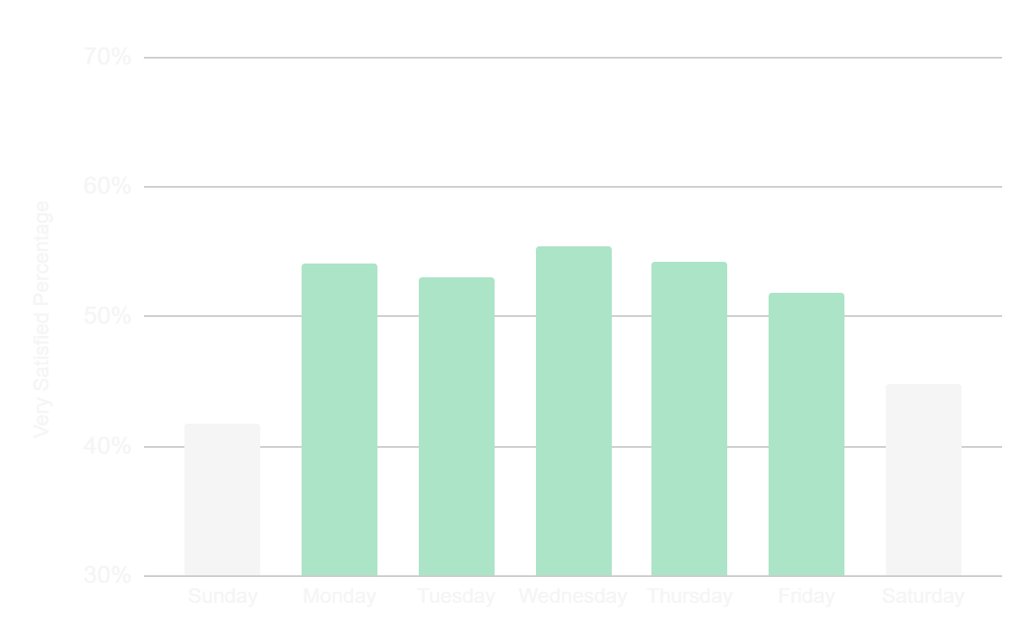
Day of Week
People report being more satisfied when surveyed on weekdays versus weekends

Slide 9
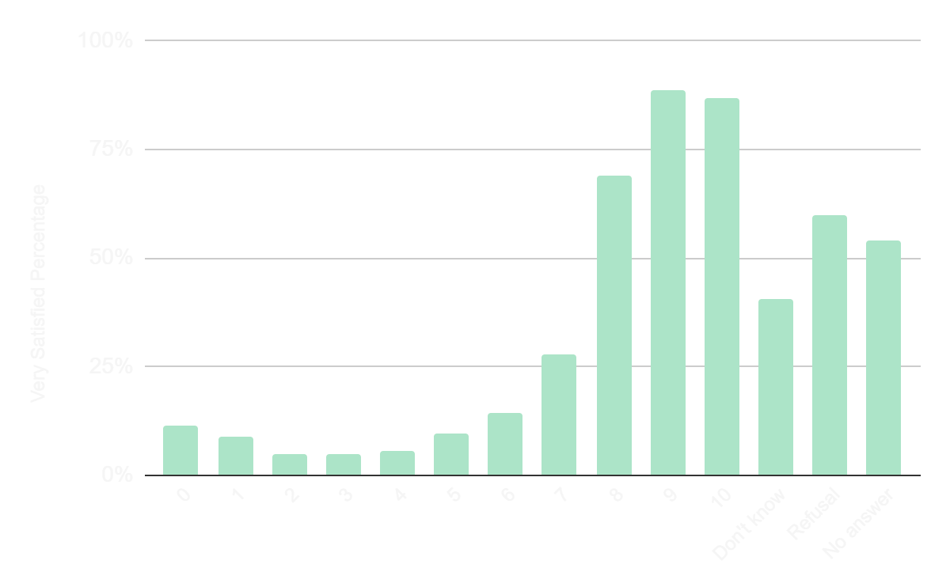
Level of Happiness
Happiness is strongly correlated to overall life satisfaction

Slide 10
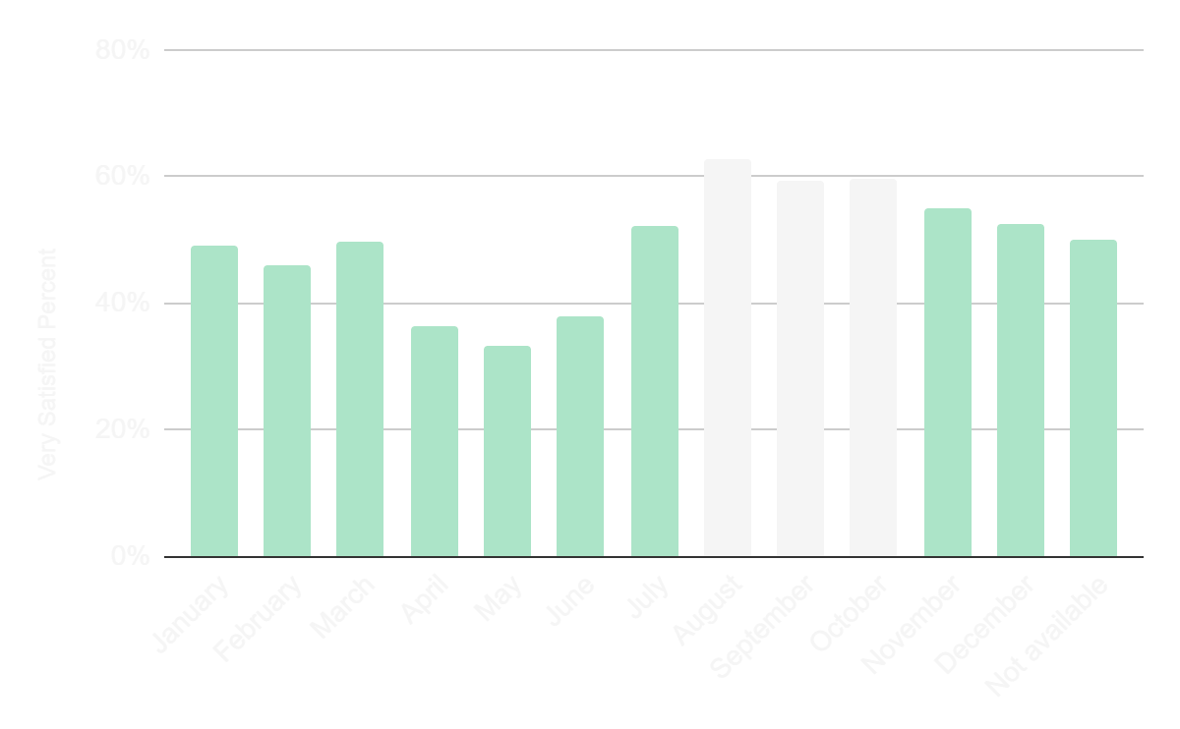
Month of Survey
Respondents report being more satisfied when surveyed between August and October

Slide 11
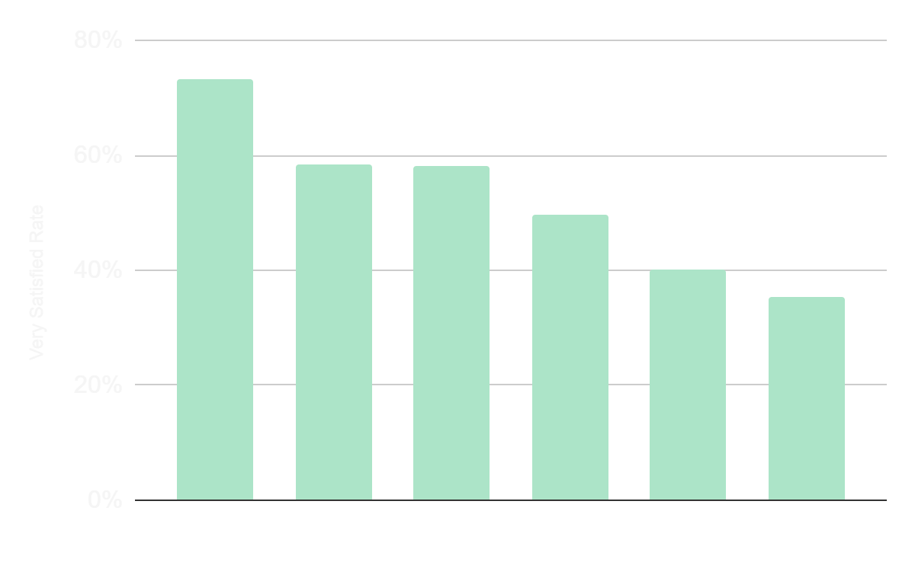
Location in Europe
Respondents from Northern Europe are most satisfied. Those from the South and East are least satisfied

Slide 12
Modelling

Slide 13
Candidate Models
Lasso Regression
Pro: Performs automatic feature selection
Con: Doesn’t account for interactions between predictors
Random Forest
Pro: Utilizes less dominant features
Con: Low interpretability
Gradient Boosted Machine
Pro: Accounts for interactions between predictors
Con: Prone to overfitting, low interpretability

Slide 14
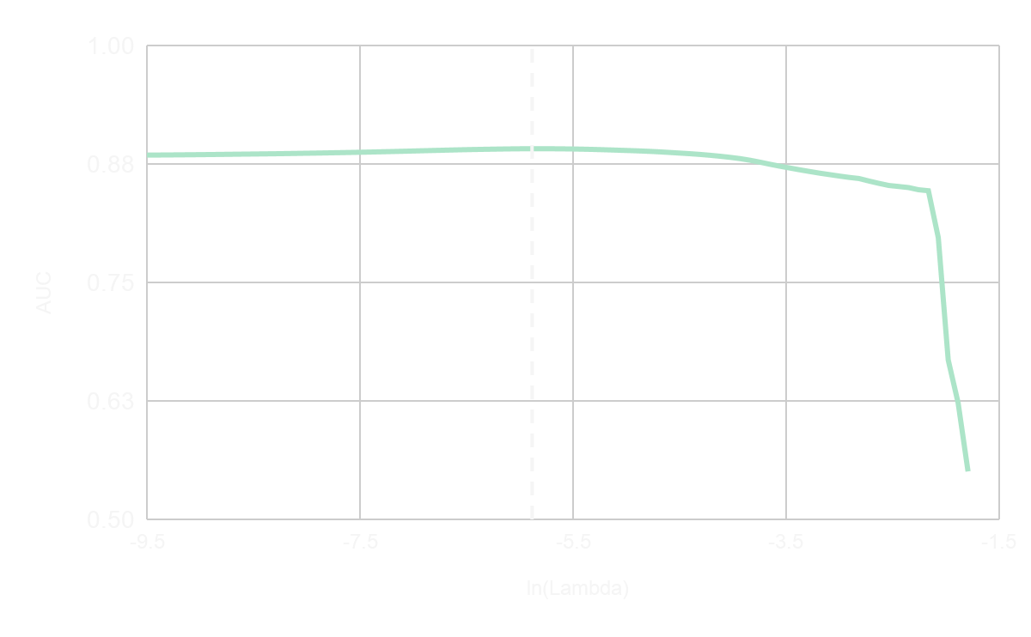
Lasso Regression - Tuning
Alpha = 1 (Lasso)
AUC is maximised at ln(Lambda) = 5.8894 (i.e. Lambda = 0.00278)

Slide 15
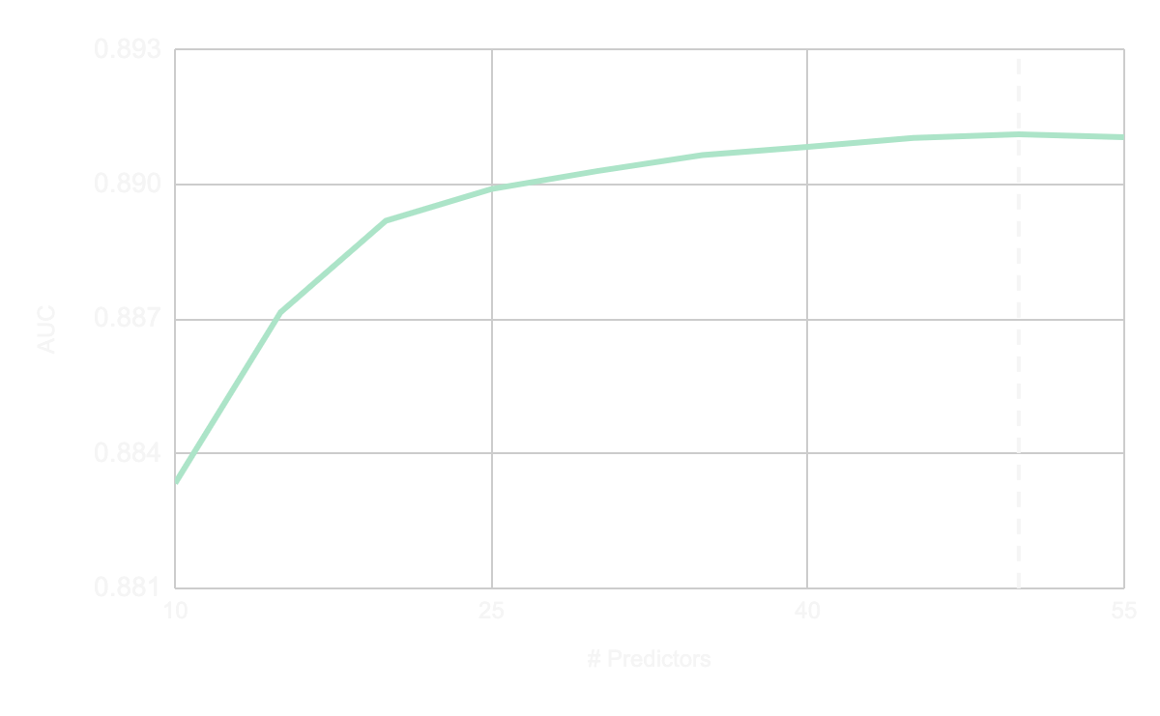
Random Forest - Tuning
# Trees = 1000, Node Size = 20
Number of trees was set at 1000 (this should be sufficient)
The best results (using the cross validated AUC) were obtained using # Predictors = 50

Slide 16
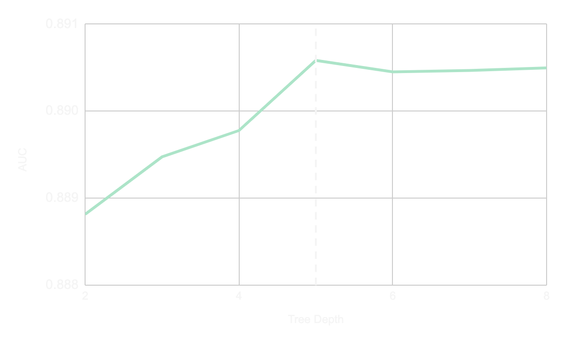
GBM - Tuning
Shrinkage = 0.005, # Trees = 1125
Number of trees calculated using early stopping (when OOB Error Improvement is 0 or less).
Noticeably better AUC for tree depth 5 and above. We take 5 to be “optimal”.

Slide 17
Stacking
Idea: Weight logits of predicted probabilities from the 3 models.
Perform cross validation, testing all 3 models on each fold
Solve for the weights that maximize the average AUC, where:
The three weights sum to 1
Each individual weight is between 0 and 1
Optimal weights: Lasso - 0.27, RF - 0.36, GBM - 0.37

Slide 18
Model Performance
Model | 5-Fold CV (x3) | Private Score | Public Score
Lasso | 0.89116 | 0.88718 | 0.87880
Random Forest | 0.89094 | 0.88433 | 0.87755
GBM | 0.89319 | 0.88826 | 0.87838
Stacking | 0.89420 | 0.88899 | 0.88061
3rd
2nd
1st

Slide 19
Most Important Features
V98: Happiness
V224: Satisfaction with present state of economy
V101: Feeling about household income
V79: Felt depressed in the past week
V74: Enjoyed life in the past week
V99: Subjective general health
V180: Believes most people can be trusted

Slide 20
Most Important Features
Measures of happiness
Respondent’s worries about health and money
What’s happened recently in the respondent’s life

Slide 21
Q&A

